Slide 1


ONLINE HOSPITAL MANAGEMENT SYSTEM
Presentation By-
Group No: 35
1) Nilesh Patil
2) Rajiv Chaudhari

Slide 2
OBJECTIVE
A patient is registered to the hospital by filling up a form.
After filling up and submission using the interface, all data will be saved in the database to the corresponding tables.
The patient is registered and then he/she will book an appointment to visit a doctor .
Then this data is transferred to the allotted doctor and receptionist where the doctor visits the patient and prescribes tests and medicines.
After the treatment is over billing is done and a receipt will be printed.

Slide 3
PROBLEM STATEMENT
The traditional methods used in the hospitals , the patients had to wait in a long queue.
This process was repeated at every step including the prescribed tests, taking reports, buying medicines, re-consulting the doctor and getting assigned the doctor which makes it a very time-taking and exhausting.
The billing is something which in hospitals is done in bits and pieces and is a problematic situation for families.
Sometimes the patients are not so educated to fill the admission forms in the hospital which causes a delay in their admission and may sometimes lead to deprivation from the facilities provided by the government and the hospital

Slide 4
PROPOSED SOLUTION
The application provides an online database of the patients to the hospital as well as the patients, which helps in their further treatment.
Patients can be directly assigned the doctor and the doctor can view the patients’ medical history just by logging in into the patient’s database, eliminating the situations of waiting in queues.
This will also allow the receptionist and the hospital staff to help the not so educated part of the society, as the people standing in the queues will be less the receptionist can easily help the people who are not introduced to the latest technologies.
The traditional methods in the hospitals used were asking the patients to pay at every step but when the patients database is accessible to the hospital staff. Then the billing can be done at the time of the discharge of the patient not at every single point.

Slide 5
Number of Modules
There are four major modules
Admin
Doctor
Patient
Receptionist

Slide 6
ADMIN
Add Staff
View Staff
Delete Staff
Staff Details
Profile
Logout

Slide 7
DOCTOR
View Appointment
Update Availability Status
Profile
Logout

Slide 8
PATIENT
View Appointment
Book Appointment
Get Information
Cancel Appointment
Profile
Logout

Slide 9
RECEPTIONIST
Add Staff
View Staff
Book Appointment
Check Appointment
Make Invoice
Confirm Appointment
Cancel Appointment
Profile
Logout

Slide 10
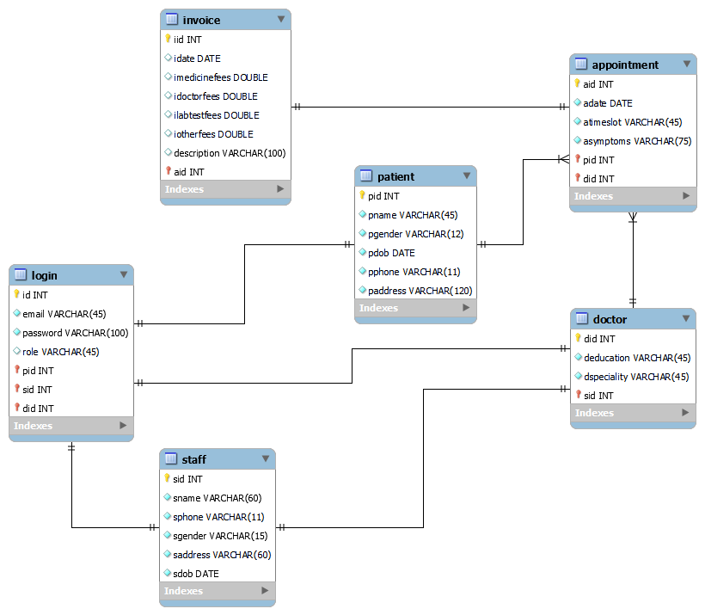
E-R Diagram

Slide 11
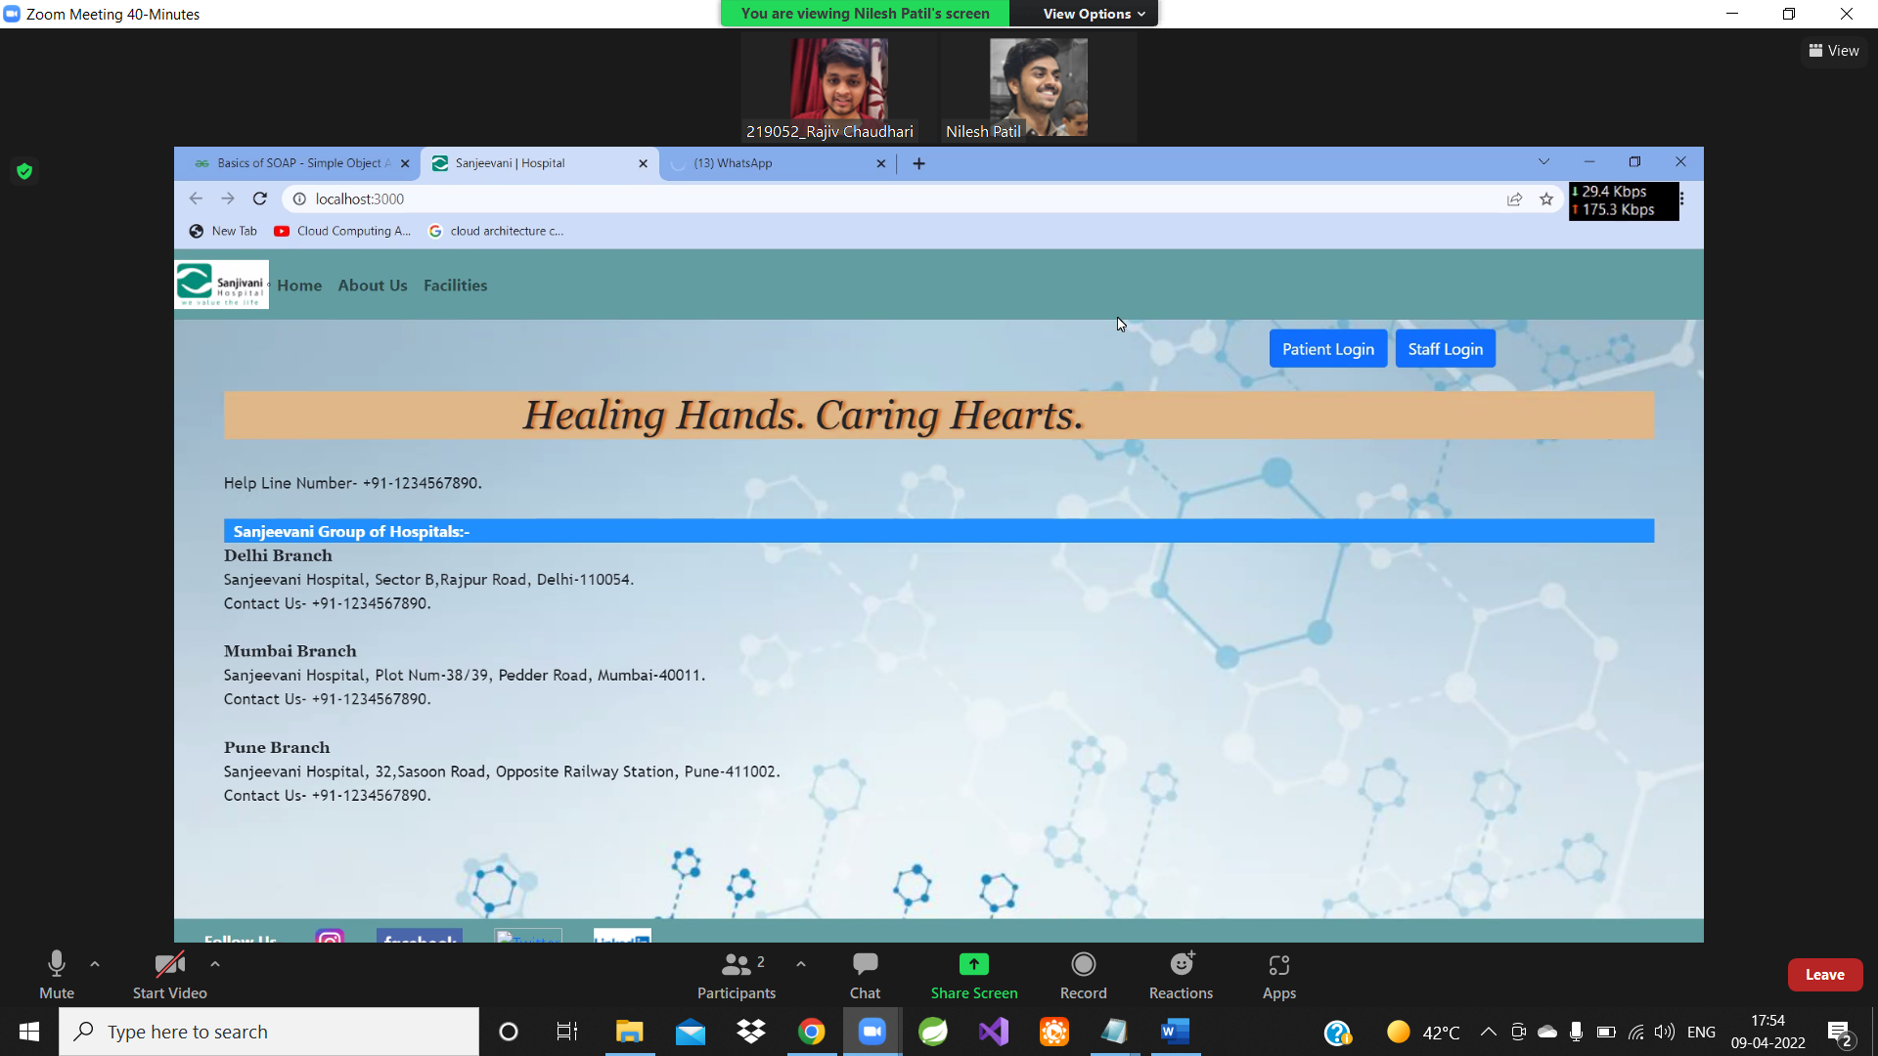
Home Page

Slide 12
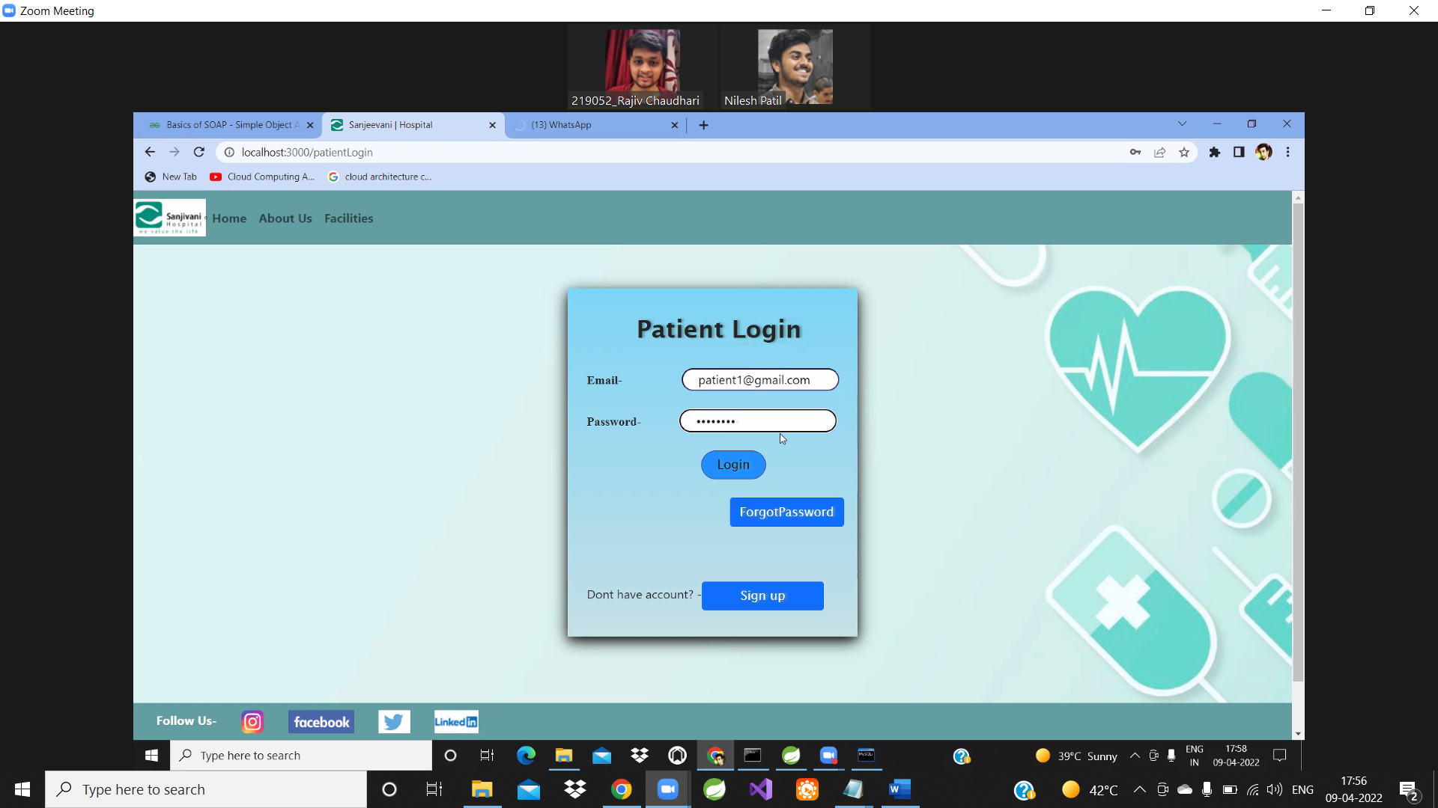
Login Page

Slide 13
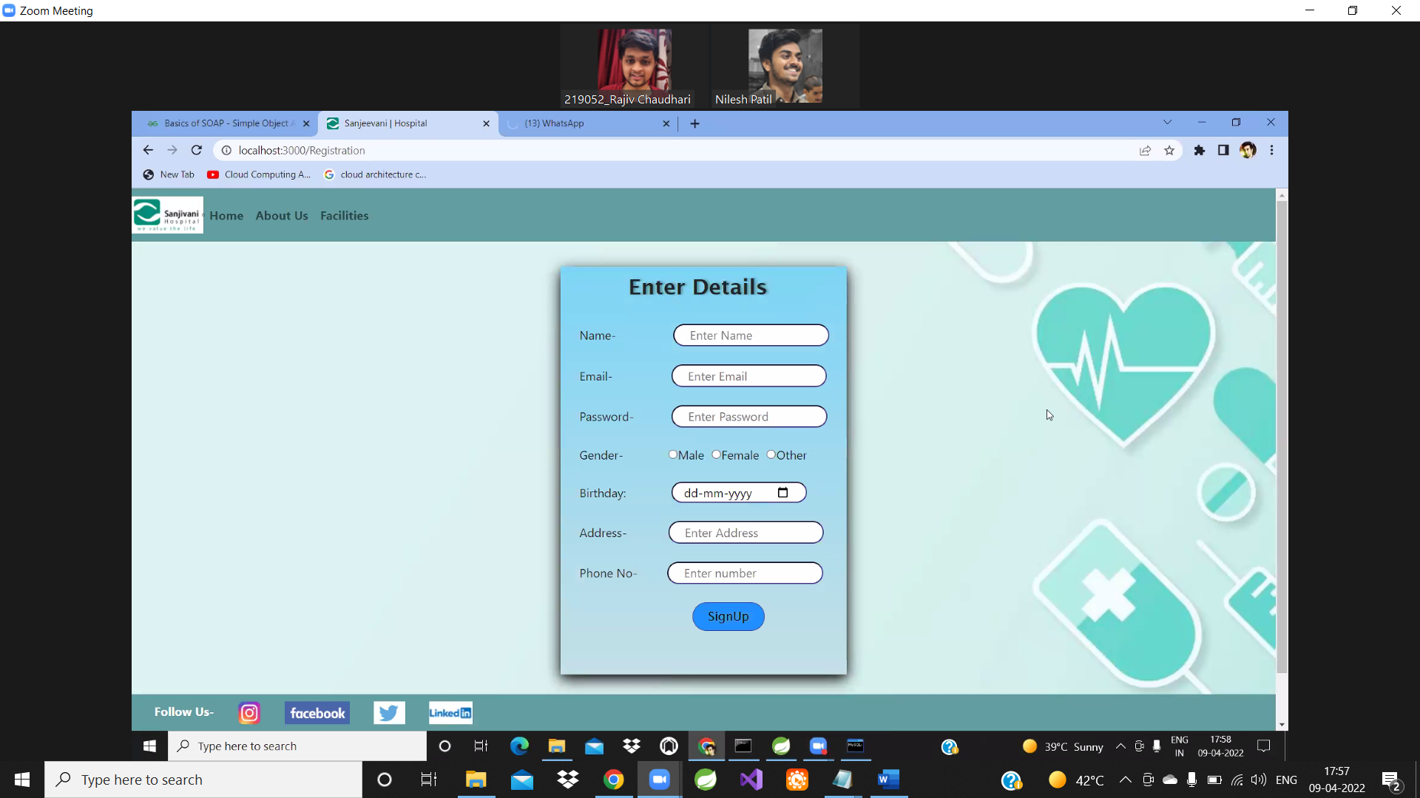
Sign Up Page

Slide 14
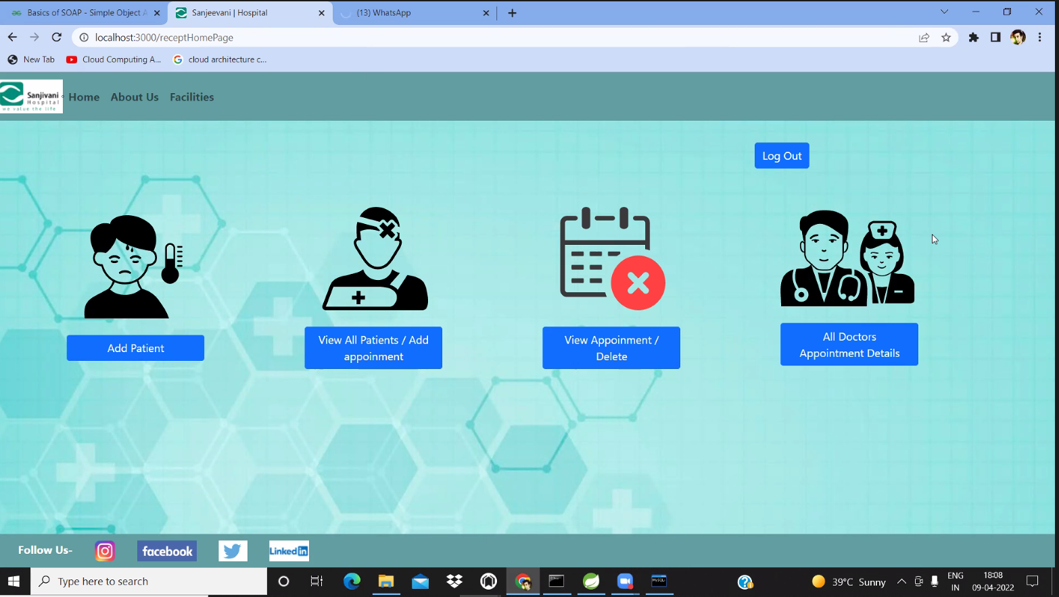
Receptionist Screen

Slide 15
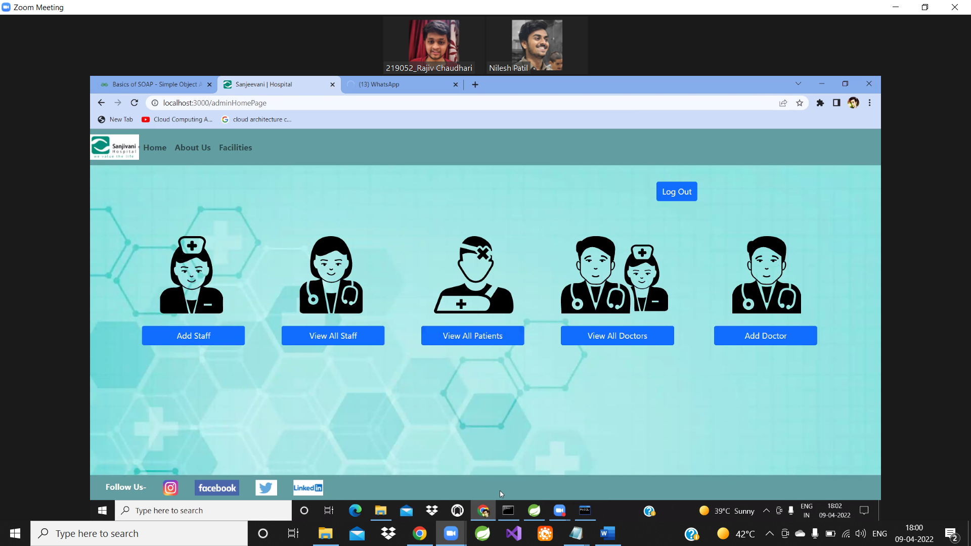
Admin Screen

Slide 16
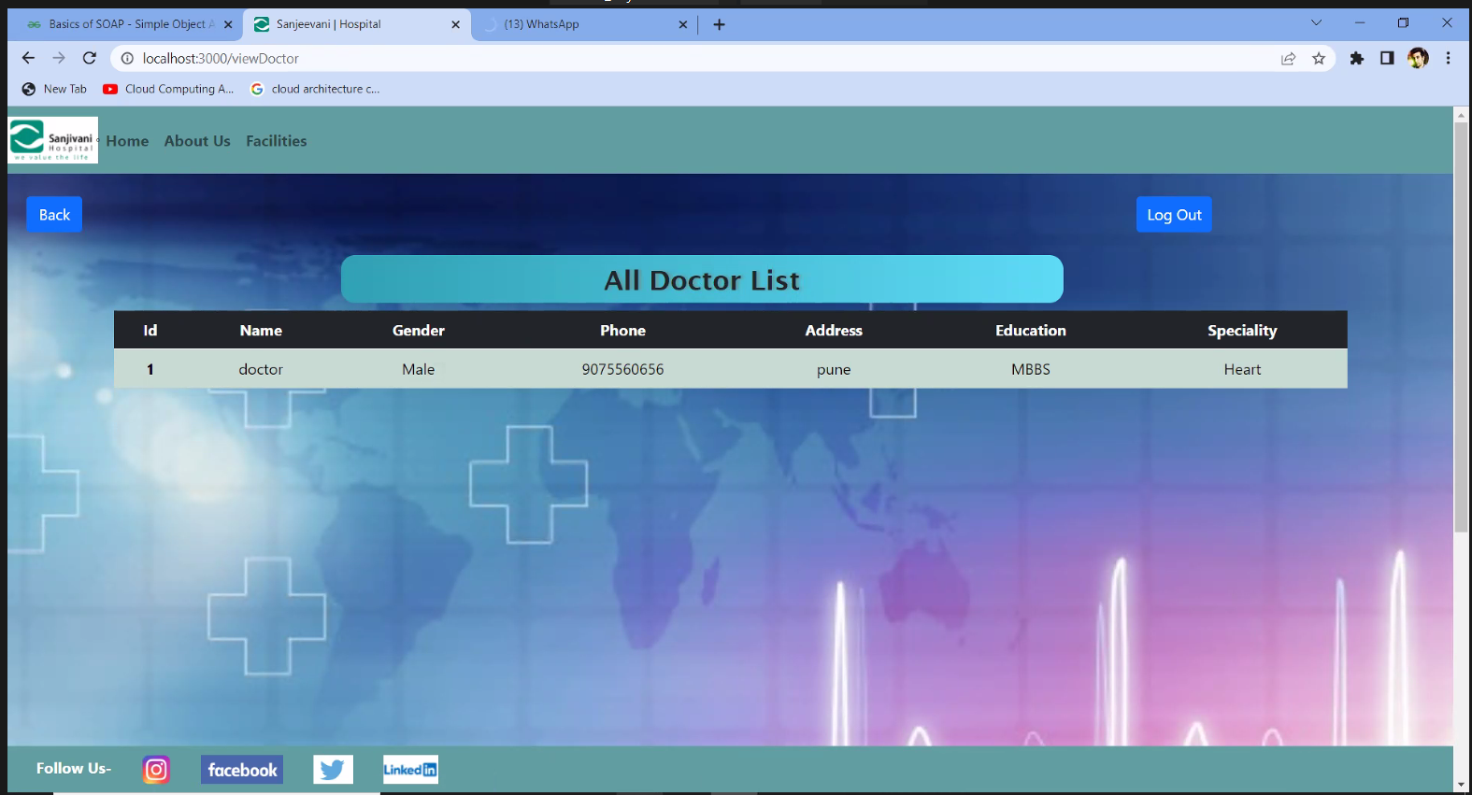
View Doctors

Slide 17
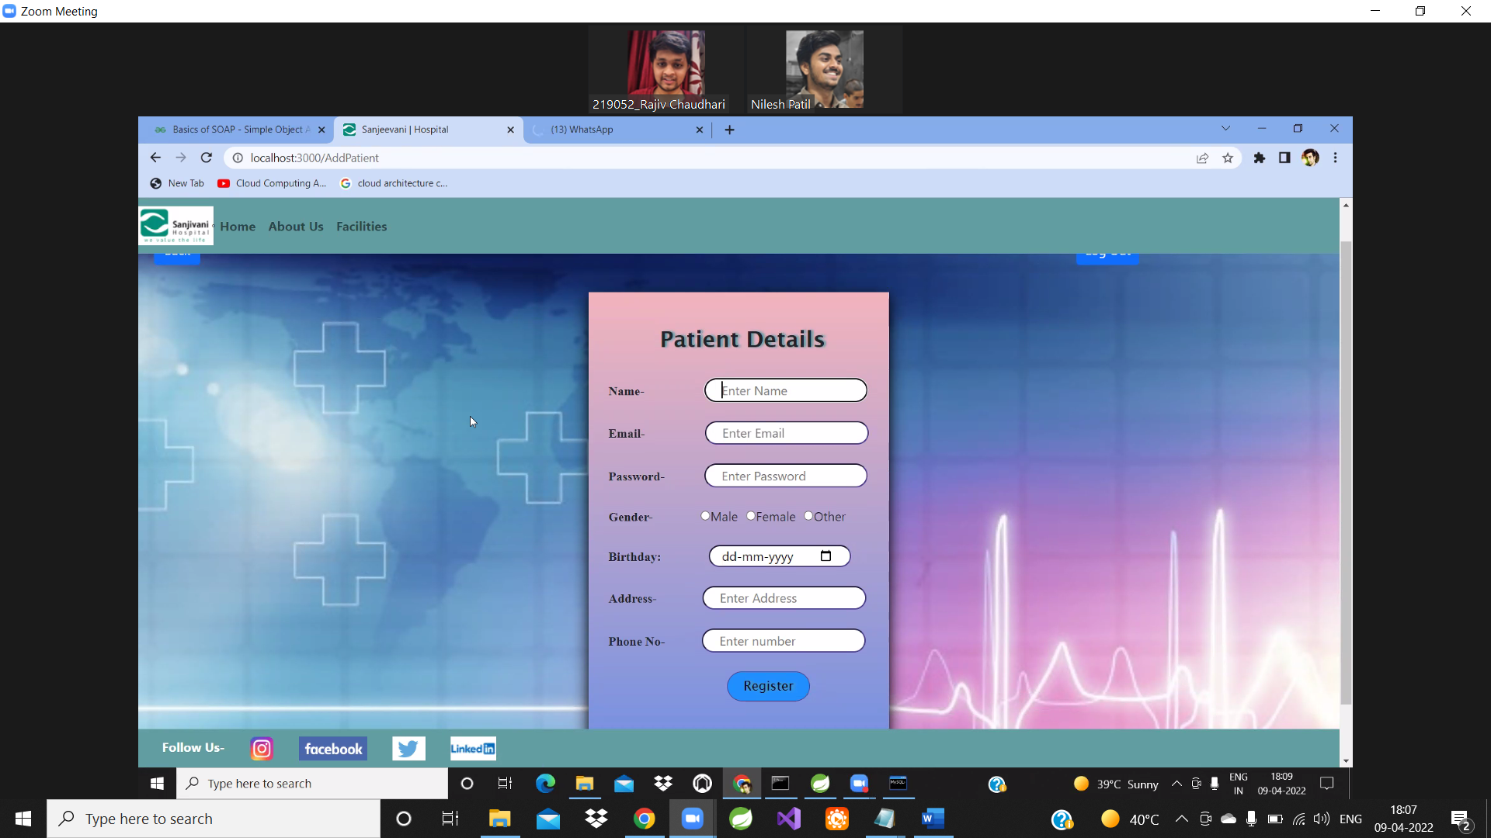
Add Patient

Slide 18
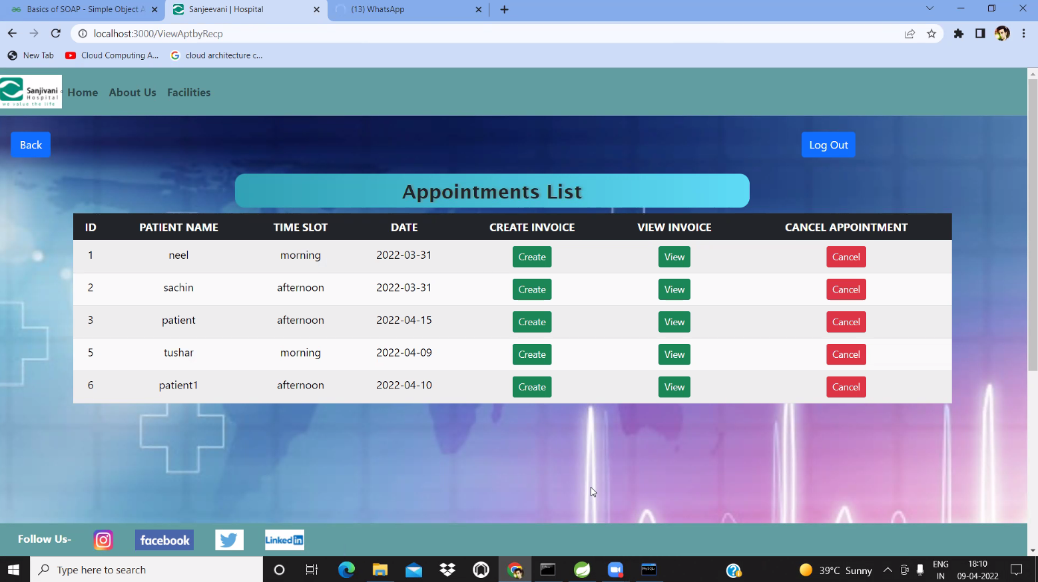
View Appointment

Slide 19
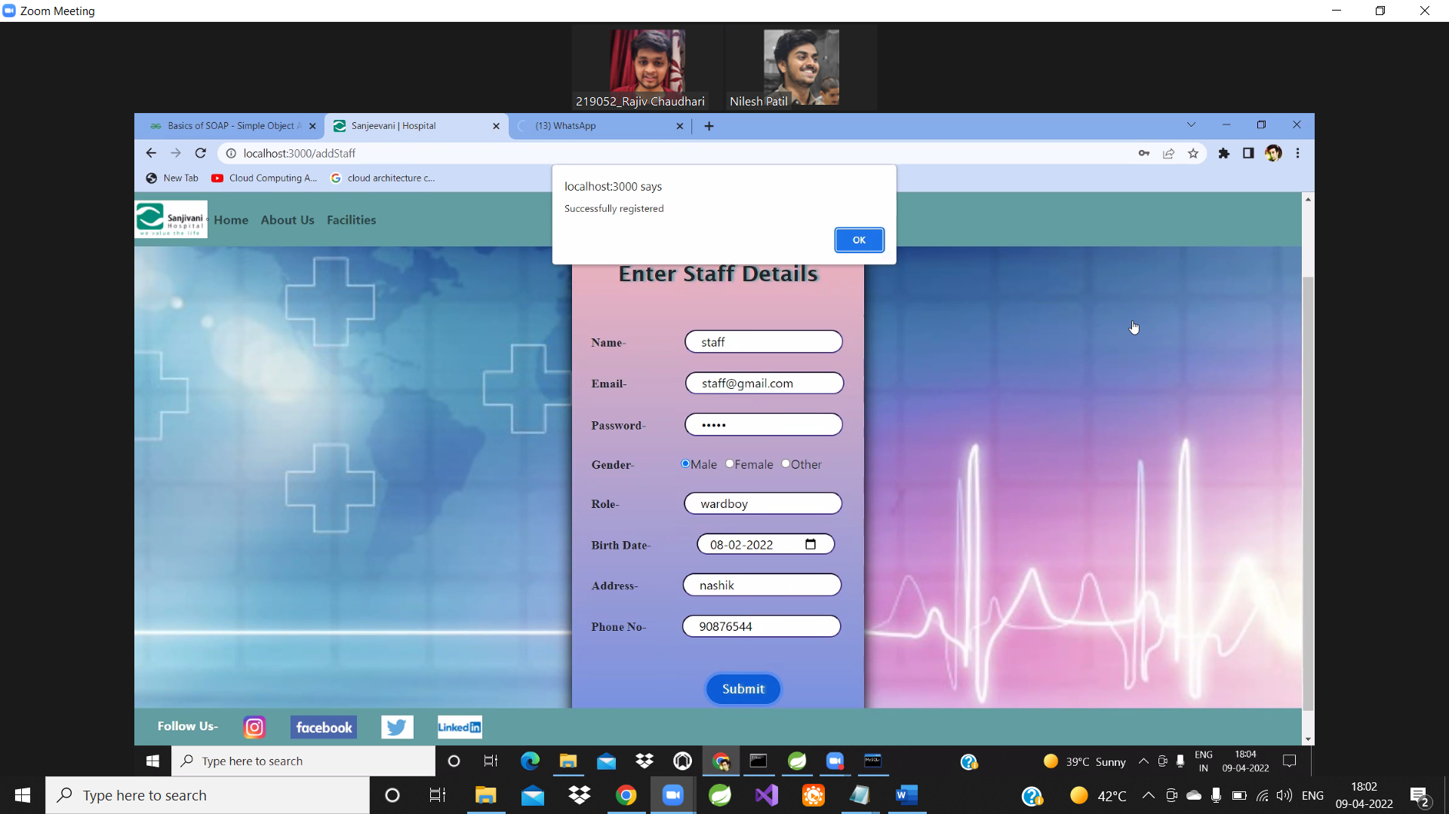
Add Staff

Slide 20
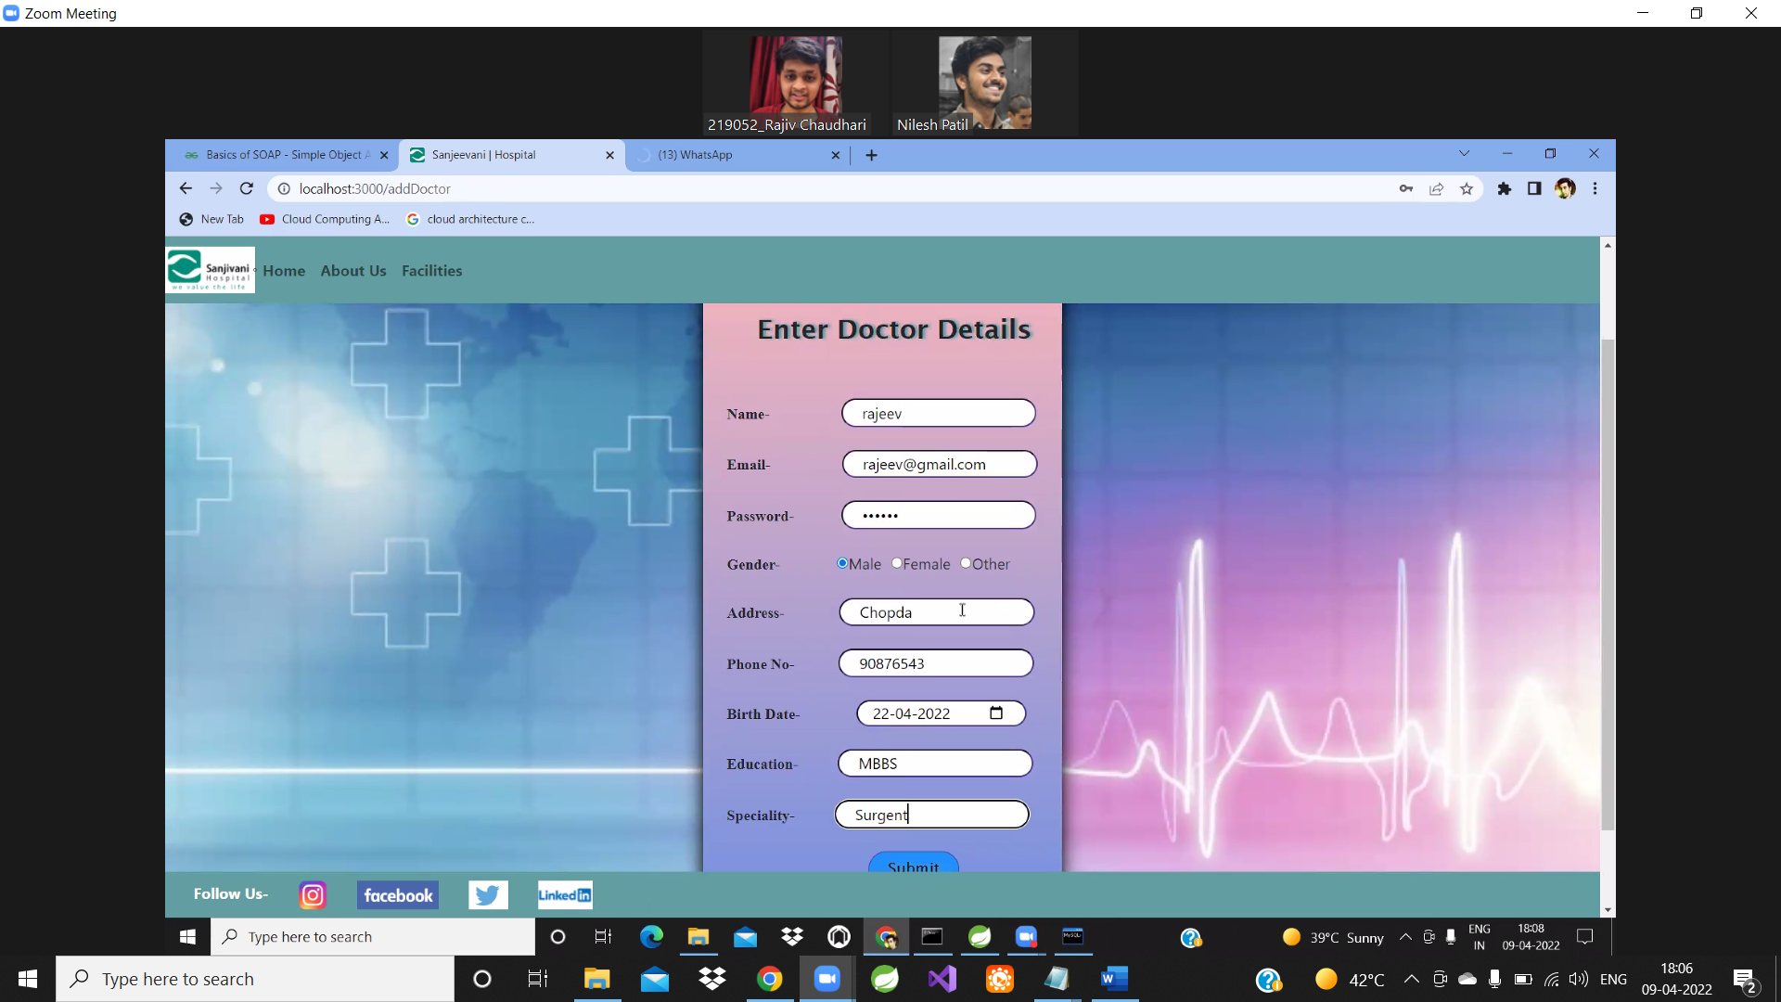
Add Doctor

Slide 21
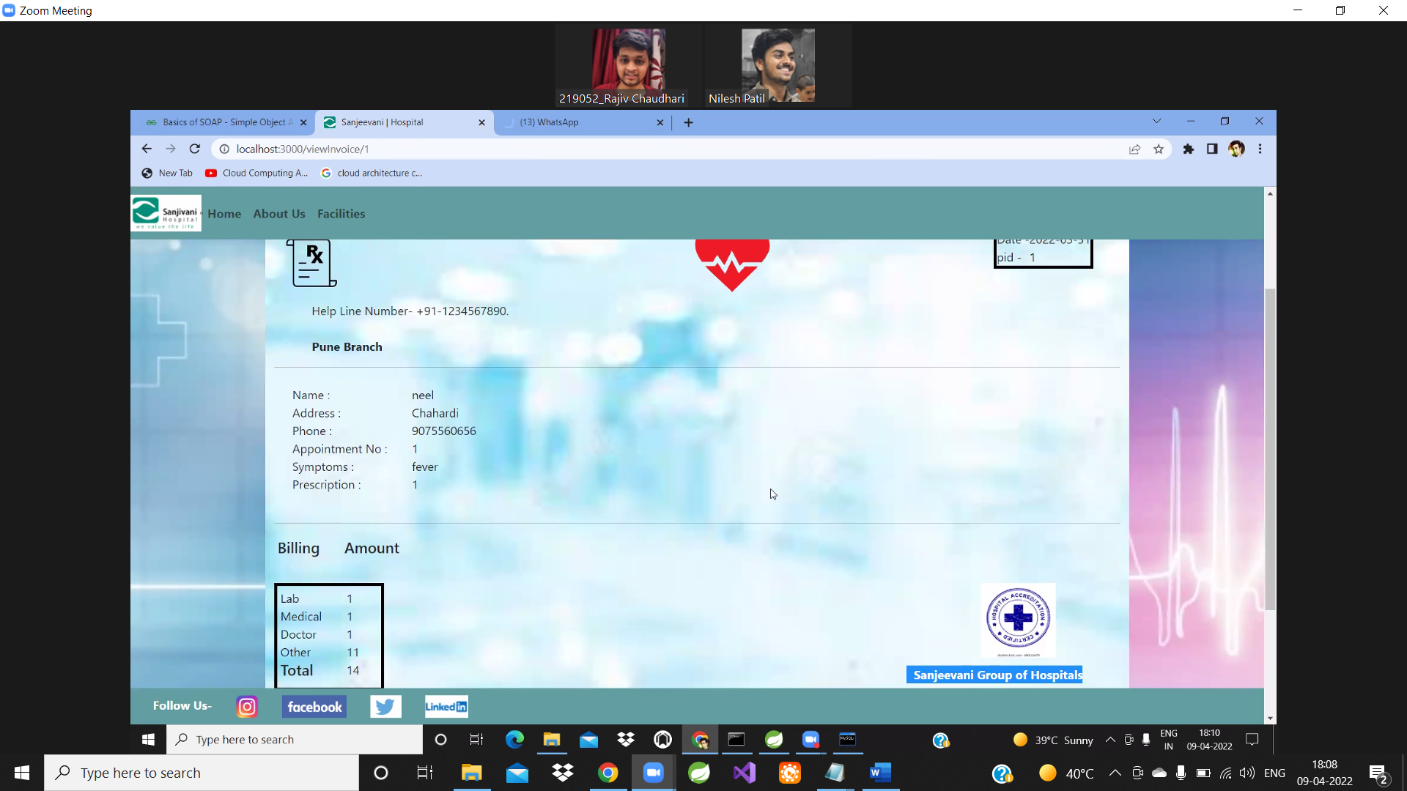
View Invoice

Slide 22
Conclusion
We minimize the efforts of the patients to book an appointment.
Our project will help to reduce the crowd contact, the patients are given appointment time slots to visit the hospital and meet the doctor. The doctor can also see the patients visiting and their health profile or symptoms.
We enable the hospital staff and management to securely save the data and fetch the data whenever necessary.
If any patient is not aware of the technology, he/she can register their data securely via receptionist.
4 kinds of users namely admin, receptionist, doctor and patient.
We have given the service to change the password after validating the user data.
We have provided static as well as dynamic pages to display data. Every specified user has our functionalities.

Slide 23
REFERENCES
Links:
https://getbootstrap.com/docs/5.1/customize
https://www.w3schools.com/css/
https://docs.oracle.com/javase/8/docs/api/
https://stackoverflow.com/
https://javaee.github.io/javaee-spec/javadocs/
https://developer.mozilla.org/en-US/docs/Web/JavaScript
https://hibernate.org/orm/
https://reactjs.org/

Slide 24
THANK YOU

